Slide 1
Block A*

Slide 2
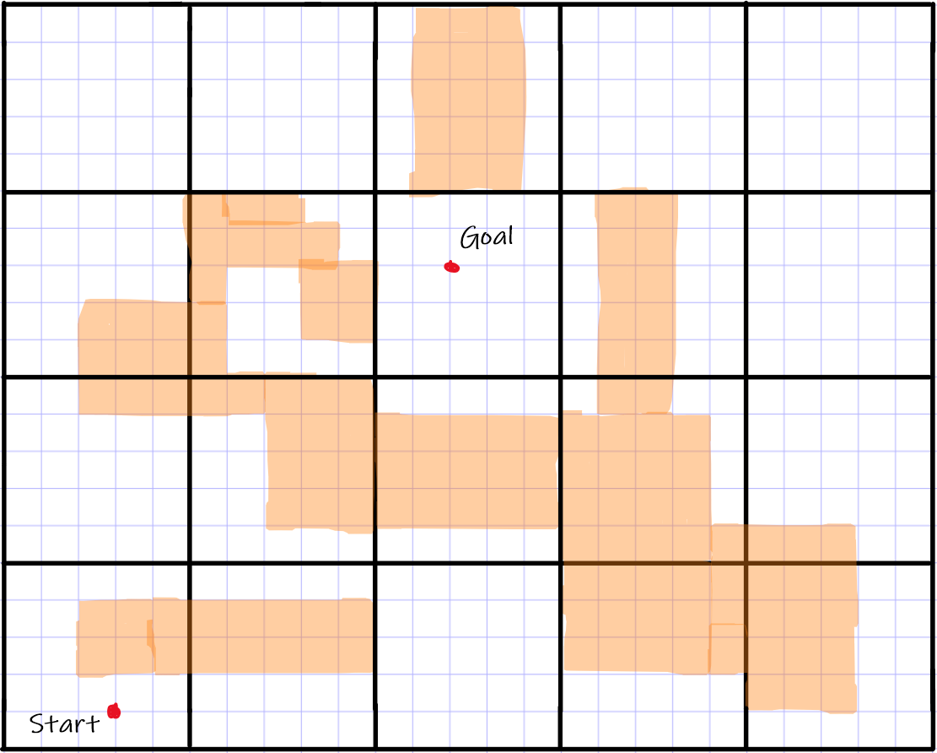

Let's suppose an environment like this and apply the block A* algorithm

Slide 3
We have 2 sub-algorithms for Block A*.
1- Expansion of the block, updation of LDDB and g-values and the heap value calculation and insertion in OPEN list.
2- Block A* execution

Slide 4

10
7.5
7.5
9
7
8
6.5
6
7
5
5.5
4
Horizontal and Vertical movement the cost =1
Added
Diagonal movements cost=1.5

Slide 5
We calculate the g-value of vertices in the boundary of the starting block
3
5.5
4
3
4

Slide 6
Then we calculate the values of the second block
8
9
3
5.5
4
3
4

Slide 7
Then we calculate the values of the second block, and so on
8
9
3
5.5
4
10.5
3
4
9

Slide 8
13
14.5
14
10
8
9
3
5.5
4
10.5
3
4
9

Slide 9
13
14.5
14
10
8
9
3
5.5
4
10.5
3
4
9
14

Slide 10
13
14.5
14
10
8
9
3
5.5
4
10.5
3
4
9
14
19

Slide 11
13
14.5
17.5
14
19.5
10
8
9
3
5.5
4
10.5
3
4
9
14
19

Slide 12
13
14.5
17.5
14
19.5
10
8
9
3
5.5
4
27.5
10.5
22.5
3
4
9
14
19
24

Slide 13
13
14.5
17.5
14
19.5
24.5
10
20.5
22.5
8
9
3
5.5
4
27.5
10.5
22.5
3
4
9
14
19
24

Slide 14
After updating the values of the blocks in our interest we just perform a simple A* to find the path but now we consider minimal values for each block.
13
14.5
17.5
14
19.5
24.5
10
20.5
22.5
8
9
3
5.5
4
27.5
10.5
22.5
3
4
9
14
19
24

Slide 15
FINAL
After the A* exection we get the path to the goal.
14.5
17.5
19.5
10
22.5
8
3

